Slide 1
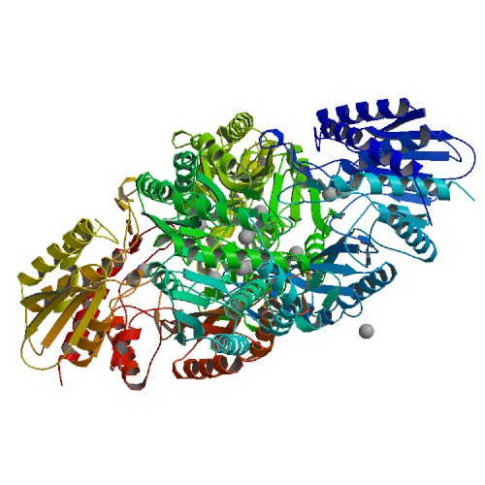
ID DB08898
GLUCARPIDASE
C₁₉₅₀H₃₁₅₇N₅₄₃O₅₉₉S₇
CATEGORY
Enzymes

Slide 2
DESCRIPTION
Glucarpidase is the recombinant form of the Pseudomonas sp. (strain RS-16) enzyme carboxypeptidase G2 that is produced in Escherichia coli. In patients, glucarpidase inactivates methotrexate, and other antifolates, by hydrolyzing glutamate on the carboxyl terminal of these compounds. Therefore since methotrexate is eliminated enzymatically and not by the kidneys, glucarpidase is indicated in patients on methotrexate treatment who have kidney dysfunction, and are experiencing an abnormally high plasma concentration of methotrexate (&gt;1 micromole per liter). Glucarpidase is marketed under the brand name VoraxazeÂ®.
INDICATION
Used in patients on methotrexate treatment who have kidney dysfunction, and are experiencing an abnormally high plasma concentration of methotrexate (&gt; 1 micromole per liter).

Slide 3
PHARMACODYNAMICS
Glucarpidase acts as an antidote to toxic methotrexate levels by elminating methotrexate by a non-kidney route.
MECHANISM OF ACTION
Glucarpidase inactivates methotrexate, and other antifolates, by hydrolyzing glutamate on the carboxyl terminal of these compounds. For methotrexate specifically, it is hydrolyzed to the inactive metabolites glutamate and 4-deoxy-4-amino-N10-methylpteroic acid (DAMPA).
TOXICITY
Most common adverse reactions include hypotension, flushing, nausea, vomiting, headache, and paresthesia.
METABOLISM
Metabolism was not determined.

Slide 4
ABSORPTION
In healthy patients not taking methotrexate, the average maximum concentration for glucarpidase was 3.3 Î¼g/mL.
HALF-LIFE
In healthy patients not taking methotrexate, glucarpidase has an elimination half-life of 5.6 hours. In patients with severe renal impairment (creatinine clearance &lt;30 mL/min), glucarpidase has an longer elimination half-life at 8.2 hours.
VOLUME OF DISTRIBUTION
Glucarpidase is likely limited to the plasma volume since its volume of distribution is 3.6 L.
CLEARANCE = In healthy patients not taking methotrexate, glucarpidase has a clearance of 7.5 mL/min.
FOOD INTERACTION
No food effects were found.

Slide 5
DRUG INTERACTION
Leucovorin
Do not administer leucovorin within 2 hours of glucarpidase due to the fact that leucovorin is degraded by glucarpidase.
TARGETS
Methotrexate

Slide 6
Voraxaze BTG International Inc.
DESCRIPTION
VORAXAZE (glucarpidase) is a carboxypeptidase produced by recombinant DNA technology in genetically modified Escherichia coli. Glucarpidase is a 390-amino acid homodimer protein with a molecular weight of 83 kDa. Each potency Unit corresponds to the enzymatic cleavage of 1 μmol/L of methotrexate per minute at 37°C.
FORMULATION
VORAXAZE is supplied as a sterile, preservative-free, white lyophilized powder in single-use vials. Each vial contains 1,000 Units of glucarpidase, lactose monohydrate (10 mg), Tris-HCl (0.6 mg) and zinc acetate dihydrate (0.002 mg).

Slide 7
Derived from E. coli
ADVERSE REACTION:
Paraesthesias, flushing, nausea and/or vomiting, hypotension, and headache, dizziness or weakness, cold sweat, itching, numbness or tingly feeling
DRUG INTERACTION
Leucovorin. Substrate Interference of folates and folate antimetabolites
Common medications checked in combination with glucarpidase:
Adenocard (adenosine)
Advair Diskus (fluticasone / salmeterol)
Amitiza (lubiprostone)
AtroPen (atropine)
Decadron (dexamethasone)
Diovan (valsartan)
Elidel (pimecrolimus topical)
Femara (letrozole)
Gralise (gabapentin)
Humalog (insulin lispro)
Imuran (azathioprine)
Morphine Rapi-Ject (morphine)
Morphine Sulfate IR (morphine)
Protonix (pantoprazole)
Reglan (metoclopramide)
Relistor (methylnaltrexone)
Singulair (montelukast)
Vitamin B Compound Strong (multivitamin)
Vitamin D3 (cholecalciferol)
Xanax (alprazolam)

Slide 8
DOSAGE: Single intravenous injection of 50 Units per kg
Clearance: 7.5 mL/min
Half-life: 5.6h
REFERENCES
http://www.ncbi.nlm.nih.gov/pubmed/24255083 http://www.ncbi.nlm.nih.gov/pubmed/24391395 http://www.ncbi.nlm.nih.gov/pubmed/22382581 http://www.ncbi.nlm.nih.gov/pubmed/22922716

