Slide 1
Exenatide (Approved investigational drug) DB01276
Category : Hypoglycemic Agents
Use : Indicated as adjunctive therapy to improve glycemic control in patients with Type 2 diabetes mellitus who are taking metformin, a sulfonylurea, or a combination of both, but have not achieved adequate glycemic control.
Target : Glucagon-like peptide 1 receptor
Half life : Mean terminal half-life is 2.4 hours.
Description : Exenatide, derived from a compound found in the saliva of the Gila monster, a large lizard native to the southwestern US, is a functional analog of Glucagon-Like Peptide-1 (GLP-1), a naturally occuring peptide.
Pharmacodynamics : Exenatide is an incretin mimetic, which has glucoregulatory effects. While it is has blood-sugar lowering actions alone, it can also be combined with other medications such as pioglitazone, metformin, sulfonylureas, and/or insulin to improve glucose control. The approved use of exenatide is with either sulfonylureas, metformin and thiazolinediones. The medication is injected twice per day using a pre-filled pen device. Typical human responses to exenatide plus eating include improvements in the initial rapid release of endogenous insulin, suppression of glucagon release by the pancreas, regulation of gastric empyting and reduced appetite; all behaviors more typical of individuals without blood sugar control problems. Exenatide is self-regulating in that in lowers blood sugar when levels are elevated but does not continue to lower blood sugar when levels return to normal, unlike with sulfonylureas or insulins.

Slide 2
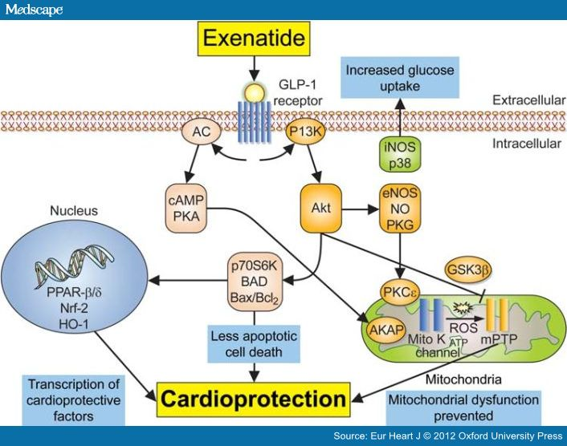

Slide 3
Mode of action : Exenatide is a functional analog of the human incretin Glucagon-Like Peptide-1 (GLP-1). Incretins enhance glucose-dependent insulin secretion and exhibit other antihyperglycemic actions following their release into the circulation from the gut. The GLP-1 system increases insulin secretion only in the presence of elevated plasma glucose levels, avoiding inappropriately high insulin levels during fasting. The drug also moderates peak serum glucagon levels during hyperglycemic periods following meals, but does not interfere with glucagon release in response to hypoglycemia. Secondary effects of drug administration reduces the rate of gastric emptying and decreases food intake, mitigating the potential severity of hyperglycemic events after meals.
Toxicity : Effects of the overdoses included severe nausea, severe vomiting, and rapidly declining blood glucose concentrations.
Absorption : Following subcutaneous administration to patients with type 2 diabetes, exenatide reaches median peak plasma concentrations in 2.1 hours.
Route of elimination : Nonclinical studies have shown that exenatide is predominantly eliminated by glomerular filtration with subsequent proteolytic degradation.
Volume of distribution : 28.3 L
Clearance : Apparent cl=9.1 L/hr

Slide 4
Sequence : HGEGTFTSDLSKQMEEEAVRLFIEWLKNGGPSSGAPPPS
Brands : Eli Lilly’s Byetta amylin
Byetta
BYETTA (exenatide) is a synthetic peptide that was originally identified in the lizard Heloderma suspectum. Exenatide differs in chemical structure and pharmacological action from insulin, sulfonylureas (including D-phenylalanine derivatives and meglitinides), biguanides, thiazolidinediones, alpha-glucosidase inhibitors, amylinomimetics and dipeptidyl peptidase-4 inhibitors.
Exenatide is a 39-amino acid peptide amide. Exenatide has the empirical formula C₁₈₄H₂₈₂N₅₀O₆₀S and molecular weight of 4186.6 Daltons. The amino acid sequence for exenatide is shown below.
H-His-Gly-Glu-Gly-Thr-Phe-Thr-Ser-Asp-Leu-Ser-Lys-Gln-Met-Glu-Glu-Glu-Ala-Val-Arg-Leu -Phe-Ile-Glu-Trp-Leu-Lys-Asn-Gly-Gly-Pro-Ser-Ser-Gly-Ala-Pro-Pro-Pro-Ser-NH2
BYETTA (exenatide injection) is supplied for SC injection as a sterile, preserved isotonic solution in a glass cartridge that has been assembled in a pen-injector (pen). Each milliliter (mL) contains 250 micrograms (mcg) synthetic exenatide, 2.2 mg metacresol as an antimicrobial preservative, mannitol as a tonicity-adjusting agent, and glacial acetic acid and sodium acetate trihydrate in water for injection as a buffering solution at pH 4.5. Two prefilled pens are available to deliver unit doses of 5 mcg or 10 mcg. Each prefilled pen will deliver 60 doses to provide for 30 days of twice daily administration (BID).

Slide 5
Indication : Type 2 Diabetes Mellitus
BYETTA (exenatide injection) is indicated as an adjunct to diet and exercise to improve glycemic control in adults with type 2 diabetes mellitus.
Important Limitations of Use
BYETTA (exenatide injection) is not a substitute for insulin. BYETTA (exenatide injection) should not be used in patients with type 1 diabetes or for the treatment of diabetic ketoacidosis, as it would not be effective in these settings. The concurrent use of BYETTA (exenatide injection) with insulin has not been studied and cannot be recommended. Based on postmarketing data BYETTA (exenatide injection) has been associated with acute pancreatitis, including fatal and non-fatal hemorrhagic or necrotizing pancreatitis. BYETTA (exenatide injection) has not been studied in patients with a history of pancreatitis. It is unknown whether patients with a history of pancreatitis are at increased risk for pancreatitis while using BYETTA (exenatide injection) . Other antidiabetic therapies should be considered in patients with a history of pancreatitis.

Slide 6
Recommended Dosing : BYETTA (exenatide injection) should be initiated at 5 mcg administered twice daily at any time within the 60-minute period before the morning and evening meals (or before the two main meals of the day, approximately 6 hours or more apart). BYETTA (exenatide injection) should not be administered after a meal. Based on clinical response, the dose of BYETTA (exenatide injection) can be increased to 10 mcg twice daily after 1 month of therapy. Initiation with 5 mcg reduces the incidence and severity of gastrointestinal side effects. Each dose should be administered as a subcutaneous (SC) injection in the thigh, abdomen, or upper arm. No data are available on the safety or efficacy of intravenous or intramuscular injection of BYETTA (exenatide injection) . Use BYETTA (exenatide injection) only if it is clear, colorless and contains no particles.
Overdose : In a clinical study of BYETTA (exenatide injection) , three patients with type 2 diabetes each experienced a single overdose of 100 mcg SC (10 times the maximum recommended dose). Effects of the overdoses included severe nausea, severe vomiting, and rapidly declining blood glucose concentrations. One of the three patients experienced severe hypoglycemia requiring parenteral glucose administration. The three patients recovered without complication. In the event of overdose, appropriate supportive treatment should be initiated according to the patient's clinical signs and symptoms.
Contraindications : Hypersensitivity
BYETTA (exenatide injection) is contraindicated in patients with prior severe hypersensitivity reactions to exenatide or to any of the product components.

Slide 7
General reference : Heine RJ, Van Gaal LF, Johns D, Mihm MJ, Widel MH, Brodows RG: Exenatide versus insulin glargine in patients with suboptimally controlled type 2 diabetes: a randomized trial. Ann Intern Med. 2005 Oct 18;143(8):559-69. "Pubmed":http://www.ncbi.nlm.nih.gov/pubmed/16230722
www.drugbank.com
www.rxlist .com

