Slide 1
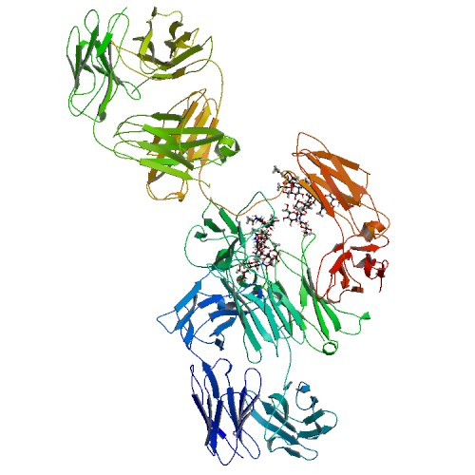
Daclizumab (Approved investigational)
Drugbank ID : DB00111
Half life : 11-38 days
Categories :
Immunosuppressive Agents

Slide 2
Description :
Humanized IgG1 Mab that binds to the human interleukin-2 receptor (anti-Tac or anti-CD25). Daclizumab is a composite of human (90%) and murine (10%) antibody sequences. The human sequences were derived from the constant domains of human IgG1 and the variable framework regions of the Eu myeloma antibody. The murine sequences were derived from the complementarity-determining regions of a murine anti-Tac antibody..
Indication :
Zenapax is a humanized monoclonal antibody used for prevention of renal transplant rejection.
Pharmacodynamics :
Zenapax functions as an IL-2 receptor antagonist. Specifically it inhibits IL-2-mediated activation of lymphocytes, a critical pathway in the cellular immune response involved in allograft rejection.

Slide 3
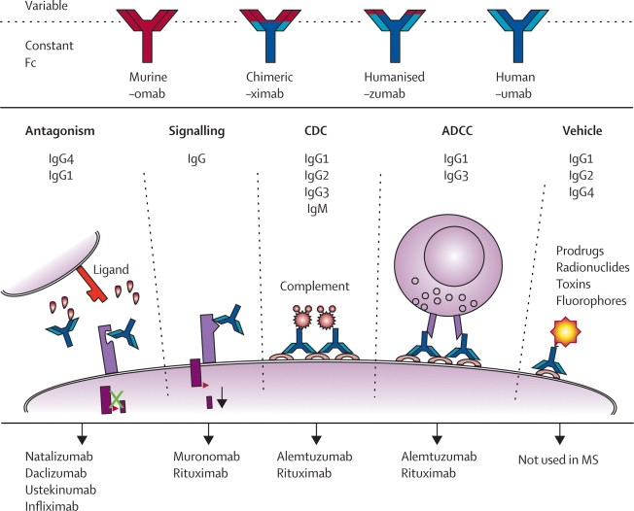
Mechanism of action :
Zenepax binds with high-affinity to the Tac subunit of the high-affinity IL-2 receptor complex and inhibits IL-2 binding. The IL-2 receptor (Tac) subunit is expressed on activated but not resting lymphocytes.

Slide 4
Targets : Interleukin-2 receptor subunit alpha,Interleukin-2 receptor subunit beta, Low affinity immunoglobulin gamma Fc region receptor III-B,Complement C1r subcomponent, Complement C1q subcomponent subunit A, Complement C1q subcomponent subunit B,Complement C1q subcomponent subunit C,Low affinity immunoglobulin gamma Fc region receptor III-A,High affinity immunoglobulin gamma Fc receptor I, Low affinity immunoglobulin gamma Fc region receptor II-a,Low affinity immunoglobulin gamma Fc region receptor II-b,Low affinity immunoglobulin gamma Fc region receptor II-c
Affected organisms : Humans and other mammals
Metabolism : Most likely removed by opsonization via the reticuloendothelial system when bound to lymphocytes.

Slide 5
Sequence :
>Humanized Anti-CD25 Heavy Chain 1
QVQLVQSGAEVKKPGSSVKVSCKASGYTFTSYRMHWVRQAPGQGLEWIGYINPSTGYTEY
NQKFKDKATITADESTNTAYMELSSLRSEDTAVYYCARGGGVFDYWGQGTTLTVSSGPSV
FPLAPSSKSTSGGTAALGCLVKDYFPEPVTVSWNSGALTSGVHTFPAVLQSSGLYSLSSV
VTVPSSSLGTQTYICNVNHKPSNTKVDKKAEPKSCDKTHTCPPCPAPELLGGPSVFLFPP
KPKDTLMISRTPEVTCVVVDVSHEDPEVKFNWYVDGVEVHNAKTKPREEQYNSTYRVVSV
LTVLHQDWLNGKEYKCKVSNKALPAPIEKTISKAKGQPREPQVYTLPPSRDELTKNQVSL
TCLVKGFYPSDIAVEWESNGQPENNYKTTPPVLDSDGSFFLYSKLTVDKSRWQQGNVFSC
SVMHEALHNHYTQKSLSLSPGK
>Humanized Anti-CD25 Light Chain 1
DIQMTQSPSTLSASVGDRVTITCSASSSISYMHWYQQKPGKAPKLLIYTTSNLASGVPAR
FSGSGSGTEFTLTISSLQPDDFATYYCHQRSTYPLTFGSGTKVEVKRTVAAPSVFIFPPS
DEQLKSGTASVVCLLNNFYPREAKVQWKVDNALQSGNSQESVTEQDSKDSTYSLSSTLTL
SKADYEKHKVYACEVTHQGLSSPVTKSFNR

Slide 6
Brands : Zenapax
ZENAPAX (daclizumab) is an immunosuppressive, humanized IgG1 monoclonal antibody produced by recombinant DNA technology that binds specifically to the alpha subunit (p55 alpha, CD25, or Tac subunit) of the human high-affinity interleukin-2 (IL-2) receptor that is expressed on the surface of activated lymphocytes.
Daclizumab is a composite of human (90%) and murine (10%) antibody sequences. The human sequences were derived from the constant domains of human IgG1 and the variable framework regions of the Eu myeloma antibody. The murine sequences were derived from the complementarity-determining regions of a murine anti-Tac antibody. The molecular weight predicted from the DNA sequence is 144 kilodaltons.
ZENAPAX (daclizumab) 25 mg/5 mL is supplied as a clear, sterile, colorless concentrate for further dilution and intravenous administration. Each milliliter of ZENAPAX contains 5 mg of daclizumab and 3.6 mg sodium phosphate monobasic monohydrate, 11 mg sodium phosphate dibasic heptahydrate, 4.6 mg sodium chloride, 0.2 mg polysorbate 80, and may contain hydrochloric acid or sodium hydroxide to adjust the pH to 6.9. No preservatives are added.
Indications : ZENAPAX (daclizumab) is indicated for the prophylaxis of acute organ rejection in patients receiving renal transplants. It is used as part of an immunosuppressive regimen that includes cyclosporine and corticosteroids.
The efficacy of ZENAPAX (daclizumab) for the prophylaxis of acute rejection in recipients of other solid organ allografts has not been demonstrated.
Dosage : ZENAPAX (daclizumab) is used as part of an immunosuppressive regimen that includes cyclosporine and corticosteroids. The recommended dose for ZENAPAX (daclizumab) in adult and pediatric patients is 1.0 mg/kg (see PRECAUTIONS: Pediatric Use). The calculated volume of ZENAPAX (daclizumab) should be mixed with 50 mL of sterile 0.9% sodium chloride solution and administered via a peripheral or central vein over a 15-minute period.
Based on the clinical trials, the standard course of ZENAPAX (daclizumab) therapy is five doses. The first dose should be given no more than 24 hours before transplantation. The four remaining doses should be given at intervals of 14 days.No dosage adjustment is necessary for patients with severe renal impairment. No dosage adjustments based on other identified covariates (age, gender, proteinuria, race) are required for renal allograft patients. No data are available for administration in patients with severe hepatic impairment.

Slide 7
Drug interactions : The following medications have been administered with ZENAPAX (daclizumab) in clinical trials in renal allograft patients with no incremental increase in adverse reactions: cyclosporine, mycophenolate mofetil, ganciclovir, acyclovir, azathioprine, and corticosteroids. Very limited experience exists in these patients with the use of ZENAPAX (daclizumab) concomitantly with tacrolimus, muromonab-CD3, antithymocite globulin, and anti-lymphocyte globulin. In renal allograft recipients (n=50) treated with ZENAPAX (daclizumab) and mycophenolate mofetil, no pharmacokinetic interaction between ZENAPAX (daclizumab) and mycophenolic acid, the active metabolite of mycophenolate mofetil, was observed. However, in a large clinical study in cardiac transplant recipients (n=434), the use of ZENAPAX (daclizumab) as part of an immunosuppression regimen including cyclosporine, mycophenolate mofetil, and corticosteroids was associated with an increase in mortality, particularly in patients receiving concomitant anti-lymphocyte antibody therapy and in patients who developed severe infections
Overdose : There have not been any reports of overdoses with ZENAPAX (daclizumab) . A maximum tolerated dose has not been determined in patients. A dose of 1.5 mg/kg has been administered to bone marrow transplant recipients without any associated adverse events.

Slide 8
References : http://www.rxlist.com/zenapax-drug.htm http://www.rxlist.com/zenapax-drug/side-effects-interactions.htm www.drugbank.com

